Slide 1
Geometric Transformation
Presented by
Nasima Islam Bithi
0421312032

Slide 2
Outline
Geometric Transformation
Translation
Scaling
Rotation
Reflection
Cropping
Shearing
Affine Transformation
Projective Transformation

Slide 3
Geometric transformation
Pixel values are not changed, the positions of pixel values are changed.
Used to correct distortions, align images for panoramic stitching, or adjust images for better visualization.
Includes operations such as translation, rotation, scaling, and shearing.

Slide 4
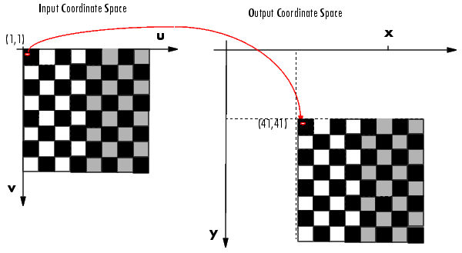

Translation
Translation means shifting the object from one position (x,y) to another position (x’, y’) based on the amount of shift in the horizontal and vertical direction, say ($t_{x} , t_{y}$).
Shifted 40 pixels in both directions

Slide 5
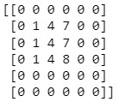
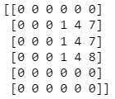
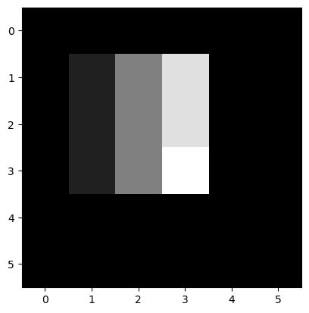
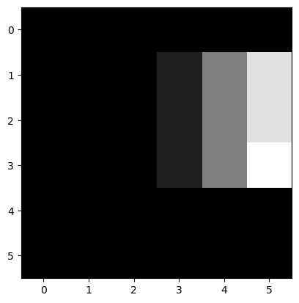
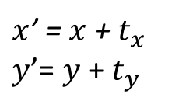



Translation Matrix
$x$’ = $x$+${ t}_{x}$
$y$’= $y$+ $t_{y}$
Translation matrix : $\left[\begin{matrix}\begin{matrix}x′ \\ y′ \\ 1\end{matrix}\end{matrix}\right]=\left[\begin{matrix}\begin{matrix}1 & 0 & t_{x} \\ 0 & 1 & t_{y} \\ 0 & 0 & 1\end{matrix}\end{matrix}\right]$ $\left[\begin{matrix}\begin{matrix}x \\ y \\ 1\end{matrix}\end{matrix}\right]$
${ t}_{x}$ = 2, $t_{y}\text{= }\text{0}$
Pixels are shifted in x direction
$x$’ = $3$ + 2 = 5
$y$’ = $2 \text{+}$ 0 = 2
x direction

Slide 6
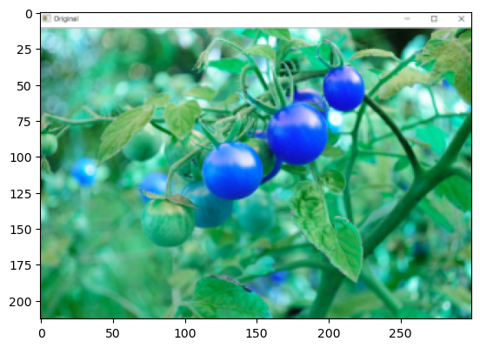
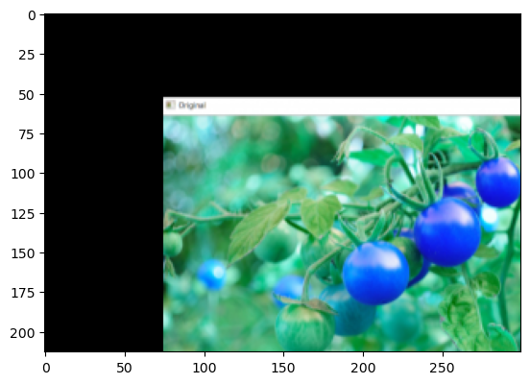
Example: Translation
(ty= 53, tx= 75)
Input Image
Translated Image

Slide 7
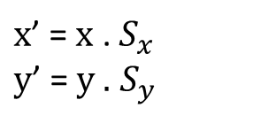
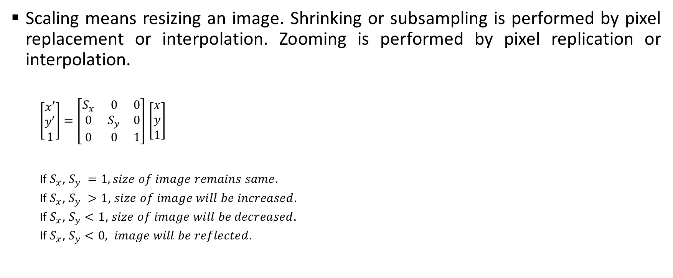

Scaling
Scaling means resizing an image. Shrinking or subsampling is performed by pixel replacement or interpolation. Zooming is performed by pixel replication or interpolation.
$\left[\begin{matrix}\begin{matrix}x′ \\ y′ \\ 1\end{matrix}\end{matrix}\right]=\left[\begin{matrix}\begin{matrix}S_{x} & 0 & 0 \\ 0 & S_{y} & 0 \\ 0 & 0 & 1\end{matrix}\end{matrix}\right]$ $\left[\begin{matrix}\begin{matrix}x \\ y \\ 1\end{matrix}\end{matrix}\right]$
If $S_{x}$, $S_{y} =1, size of image remains same.$
If $S_{x}$, $S_{y} >1$, $size of image will be increased.$
If $S_{x}$, $S_{y}<1$, $size of image will be decreased.$
If $S_{x}$, $S_{y}<0, image will be reflected.$
$x$’ = $x$ . $S_{x}$
$y$’ = $y .$ $S_{y}$
$$S_{x}= \frac{width of output image}{width of input image}$$
$$S_{y}= \frac{height of output image}{height of input image}$$

Slide 8
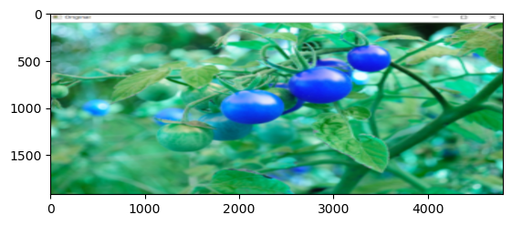
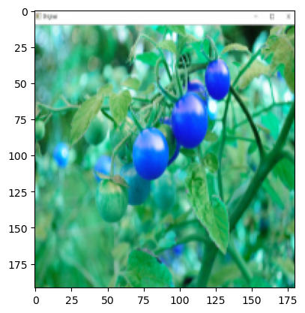
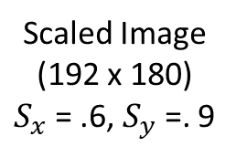
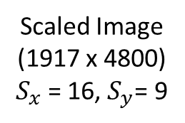
Example: Scaling
Scaled Image (1917 x 4800)
$S_{x}$= 16, $S_{y}$= 9
Scaled Image (192 x 180)
$S_{x}$= .6, $S_{y}$=. 9
Input Image (213 x 300)

Slide 9
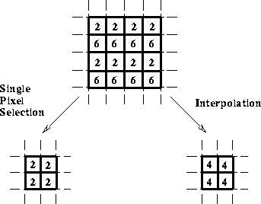



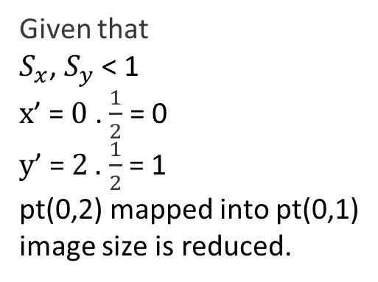
Subsampling
$S_{x}$= $\frac{1}{2}, S_{y}$= $\frac{1}{2}$
2*2 scaled image
4*4 input image
Given that
$S_{x}$, $S_{y}$ < 1
$x$’ = $0$ . $\frac{1}{2}$ = 0
$y$’ = $2 .$ $\frac{1}{2}$ = 1
pt(0,2) mapped into pt(0,1)
image size is reduced.
Fig. Methods of subsampling. a) Replacement with upper left pixel. b) Interpolation using the mean value.

Slide 10
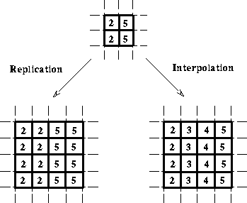



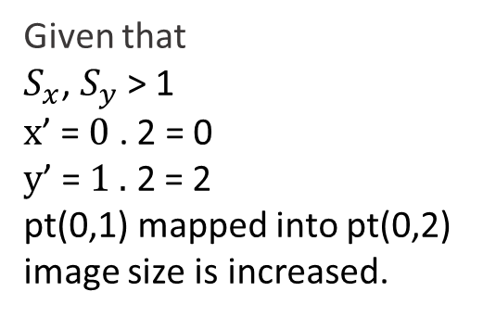
Zooming
$S_{x}$= 2 $, S_{y}$= 2
2*2 Input image
4*4 scaled image
Given that
$S_{x}$, $S_{y}$ > 1
$x$’ = $0$ . 2 = 0
$y$’ = $1 .$ 2 = 2
pt(0,1) mapped into pt(0,2)
image size is increased.
Fig. Methods of zooming. a) Replication of a single pixel value (Nearest Interpolation). b) Interpolation (Bilinear).

Slide 11
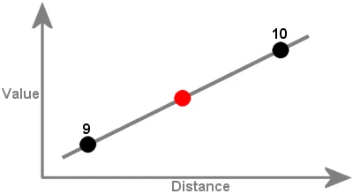
Interpolation
Interpolation is the process of estimating unknown values that fall between known values.
For zooming images, it is best to use the Nearest neighbor, Linear, Cubic, or LANCZOS4 interpolation methods. For shrinking images, it is best to use Area interpolation.
Fig: Interpolation

Slide 12

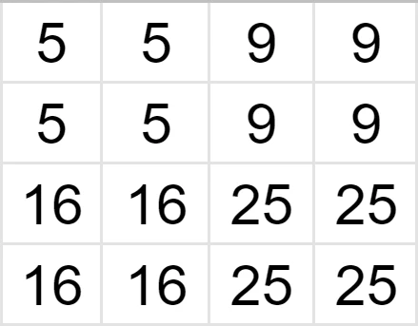
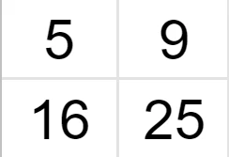
Nearest Neighbor Interpolation
The Nearest algorithm takes the known value of the one nearest pixel without paying attention to other pixels.
It retains the sharpness of the edges though the overall image may be blurred.
Suppose we have a 2x2 image and want to zoom it 2 times (so the size of the matrix becomes 4x4).
Original matrix
4x4 matrix after interpolation

Slide 13
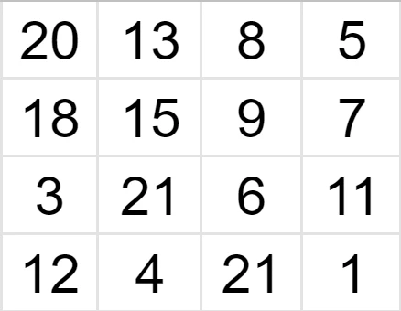
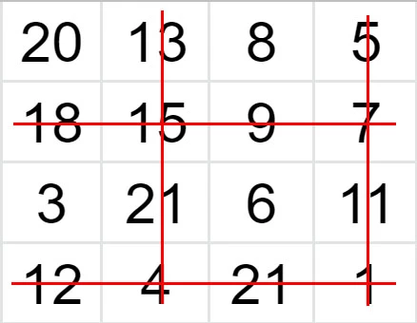
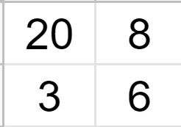
Nearest Neighbor Interpolation
Suppose we have a 4x4 image and we want to shrink it 2 times, so the new matrix is 2x2.
2x2 matrix after interpolation
Original matrix

Slide 14
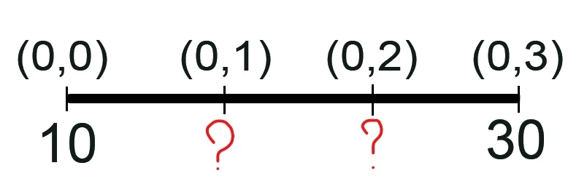
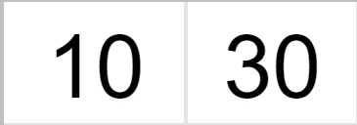
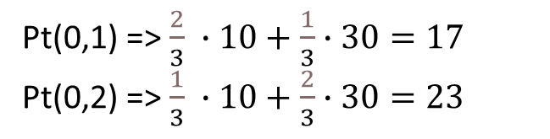
Linear Interpolation
In Linear interpolation, we find the unknown value using the weighted average of its neighbors.
effective in handling visual distortions while zooming or enlarging an image
Linear (bilinear) interpolation slightly increases the computational burden but produces better results than the nearest-neighbor method.
10 | 17 | 23 | 30
Pt(0,1) => $\frac{2}{3} ∙10+\frac{1}{3}∙30=17$
Pt(0,2) => $\frac{1}{3} ∙10+\frac{2}{3}∙30=23$

Slide 15
Cubic, Area and Lanczos4 Interpolation
Cubic interpolation uses the 16 nearest neighbors (4x4neighborhood) to calculate the unknown pixel’s value. It preserves more details than the Nearest or Linear methods but also comes with a higher computational cost.
Area interpolation is commonly exploited in geographic research. This method uses the values of known geographical points to predict values of unknown points.
LANCZOS4 interpolation uses the values of the 64 nearest pixels (8x8 neighborhood) to estimate the unknown value of the pixel. It is suited for images with large number of small size details.

Slide 16

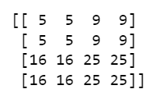
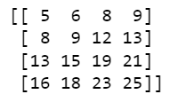
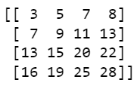
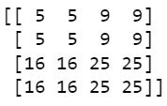
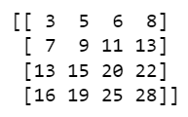
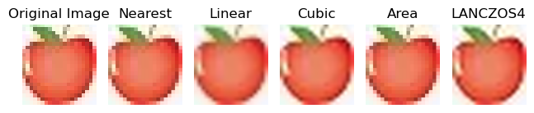
Example: Different Interpolation Methods
Input matrix
Nearest Neighbor
Linear
Cubic
Area
Lanczos4
Fig: Different methods of interpolation

Slide 17

Rotation
It turns an image in the clockwise or counter-clockwise direction by the specified number of degrees.
Angle of Rotation (θ): The angle is positive for anti-clockwise and negative for clockwise. The rotation matrix along the specific axis is defined by as follows:
Rx ($\text{θ}$) $=\left[\begin{matrix}\begin{matrix}1 & \text{0} & 0 \\ \text{0} & \text{cos}\text{θ} & −sin\text{θ} \\ 0 & sin\text{θ} & cos\text{θ}\end{matrix}\end{matrix}\right]$
Ry ($\text{θ}$) $=\left[\begin{matrix}\begin{matrix}cosθ & \text{0} & sin\text{θ} \\ \text{0} & \text{1} & 0 \\ −sin\text{θ} & 0 & cos\text{θ}\end{matrix}\end{matrix}\right]$
Rz ($\text{θ}$) $=\left[\begin{matrix}\begin{matrix}cosθ & \text{−}\text{sin}\text{θ} & 0 \\ \text{sin}\text{θ} & \text{cos}\text{θ} & 0 \\ 0 & 0 & 1\end{matrix}\end{matrix}\right]$

Slide 18
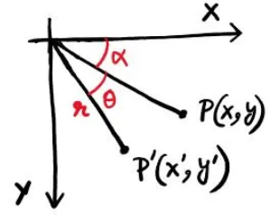
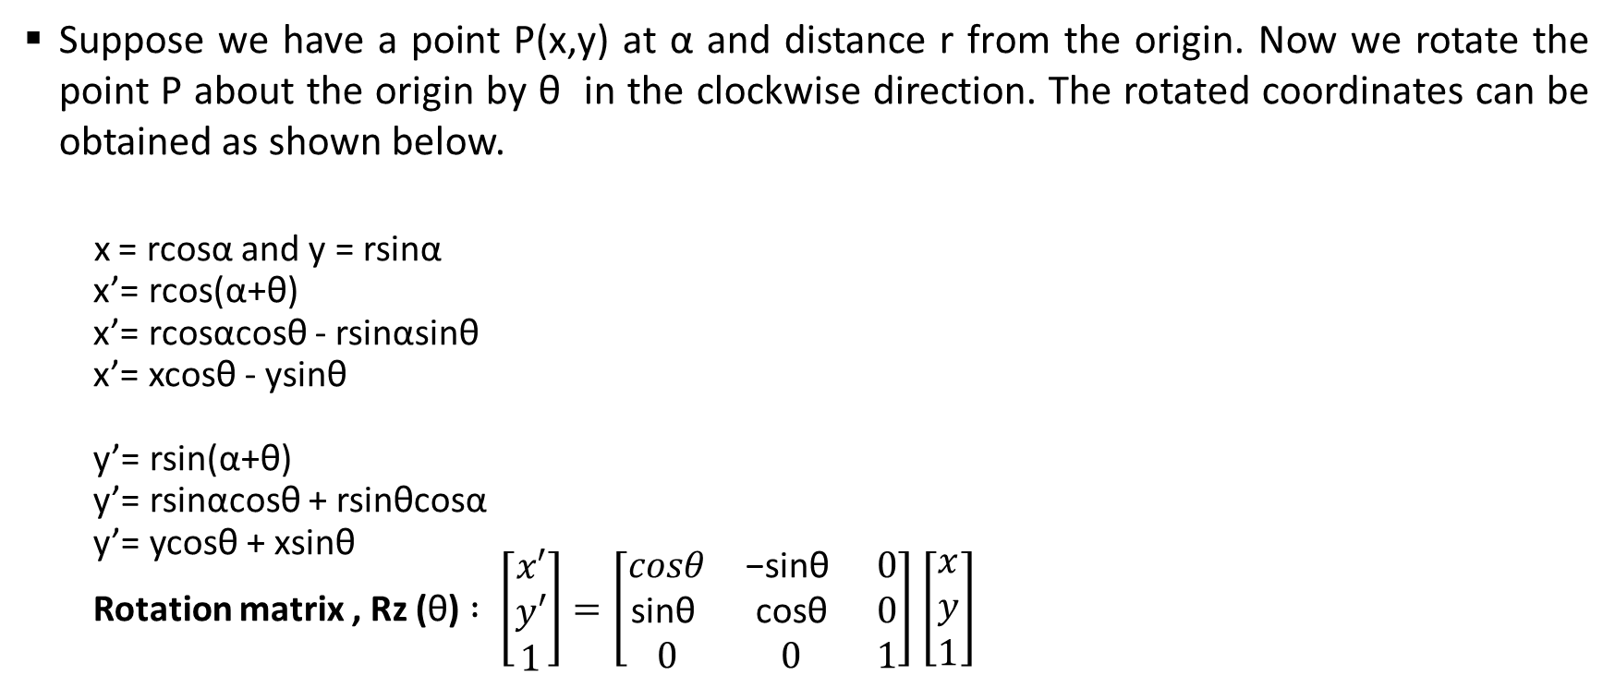
Rotation Matrix
Suppose we have a point P(x,y) at α and distance r from the origin. Now we rotate the point P about the origin by θ in the clockwise direction. The rotated coordinates can be obtained as shown below.
x = rcosα and y = rsinα
x’= rcos(α+θ)
x’= rcosαcosθ - rsinαsinθ
x’= xcosθ - ysinθ
y’= rsin(α+θ)
y’= rsinαcosθ + rsinθcosα
y’= ycosθ + xsinθ
Rotation matrix , Rz ($\text{θ}$) $: \left[\begin{matrix}\begin{matrix}x′ \\ y′ \\ 1\end{matrix}\end{matrix}\right]=\left[\begin{matrix}\begin{matrix}cosθ & \text{−}\text{sin}\text{θ} & 0 \\ \text{sin}\text{θ} & \text{cos}\text{θ} & 0 \\ 0 & 0 & 1\end{matrix}\end{matrix}\right]$ $\left[\begin{matrix}\begin{matrix}x \\ y \\ 1\end{matrix}\end{matrix}\right]$

Slide 19
Rotation of Matrix by θ
21 | 16 | 11 | 6 | 1
22 | 17 | 12 | 7 | 2
23 | 18 | 13 | 8 | 3
24 | 19 | 14 | 9 | 4
25 | 20 | 15 | 10 | 5
5 | 10 | 15 | 20 | 25
4 | 9 | 14 | 19 | 24
3 | 8 | 13 | 18 | 23
2 | 7 | 12 | 17 | 22
1 | 6 | 11 | 16 | 21
1 | 2 | 3 | 4 | 5
6 | 7 | 8 | 9 | 10
11 | 12 | 13 | 14 | 15
16 | 17 | 18 | 19 | 20
21 | 22 | 23 | 24 | 25
Θ = - 90°
Θ = 90°
25 | 24 | 23 | 22 | 21
20 | 19 | 18 | 17 | 16
15 | 14 | 13 | 12 | 11
10 | 9 | 8 | 7 | 6
5 | 4 | 3 | 2 | 1
2 | 6 | 5 | 2 | 1
13 | 12 | 9 | 6 | 3
19 | 16 | 13 | 10 | 7
19 | 20 | 17 | 14 | 10
4 | 21 | 21 | 16 | 2
Original Matrix
Θ = 180°
Θ = - 45°

Slide 20





Example: Rotation
Input Image
Θ = 90° (anticlockwise)
Θ = 180° (anticlockwise)
Θ = -90° (clockwise)
Θ = 45° (anticlockwise)
Θ =270° (anticlockwise)

Slide 21
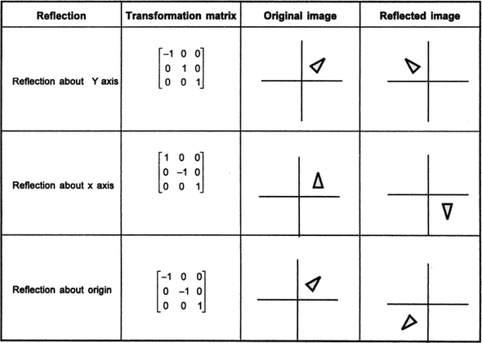
Reflection
Image reflection means flipping an image. For reflection along the x-axis, we set the value of Sy to -1, and Sx to 1, and vice-versa for the y-axis reflection.

Slide 22
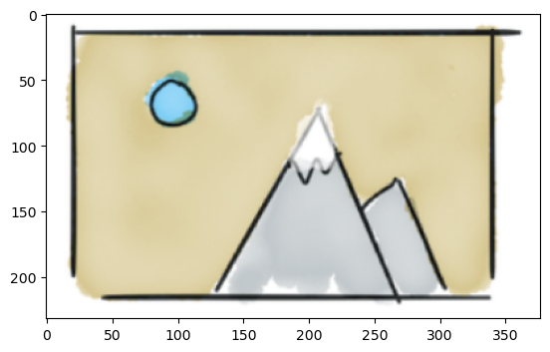
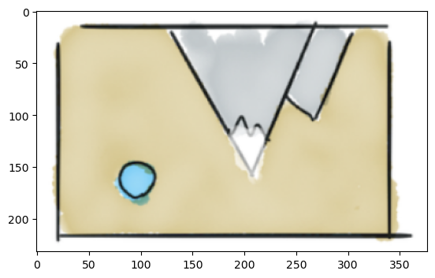
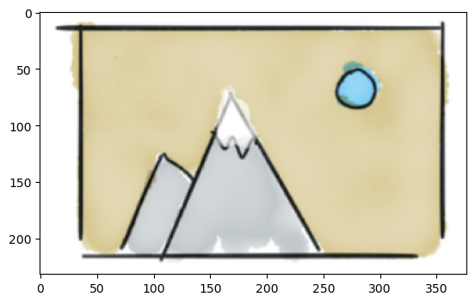
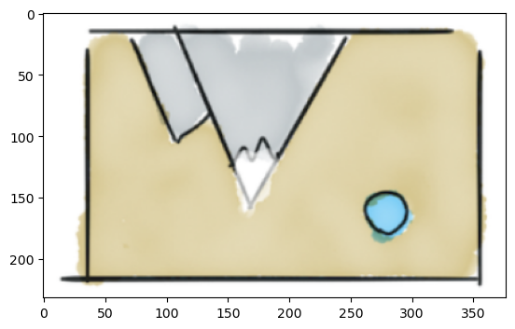
Example: Reflection
x’= x
y’= -y
Original image
Reflection about x axis
x’= -x
y’= y
x’= -x
y’= -y
Reflection about y axis
Reflection about xy axis

Slide 23
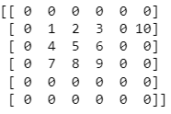
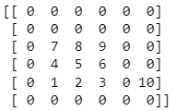
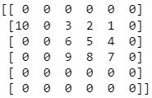
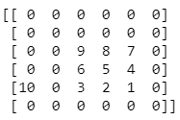
Example: Reflection
Input image
Reflection along x axis
Reflection along y axis
Reflection along xy axis

Slide 24
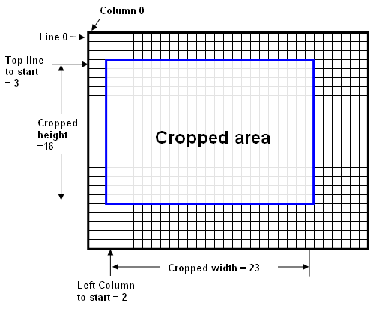


Cropping
Cropping is done by slicing the correct part out of the array.
For example,
Cropped image
from [1:3, 1:4]
Original image

Slide 25

Example: Cropping
Input Image
Cropped Image by [50:150, 100:250]

Slide 26









Shearing
Shearing is an ideal technique to change the shape of an existing object in a two-dimensional plane.
The number of rows and columns of output image is increased so that no pixels are deducted due to shear.
$$\left[\begin{matrix}\begin{matrix}1 & {Sh}_{x} & 0 \\ 0 & 1 & 0 \\ 0 & 0 & 1\end{matrix}\end{matrix}\right]$$
$$\left[\begin{matrix}\begin{matrix}1 & 0 & 0 \\ {Sh}_{y} & 1 & 0 \\ 0 & 0 & 1\end{matrix}\end{matrix}\right]$$
$$\left[\begin{matrix}\begin{matrix}1 & {Sh}_{x} & 0 \\ {Sh}_{y} & 1 & 0 \\ 0 & 0 & 1\end{matrix}\end{matrix}\right]$$
Shearing in xy-axis
$x$’ = x + $y$ .${ Sh}_{x}$
$y$’ = y + x .${ Sh}_{y}$
Shearing in x-axis
$x$’ = x + $y$ .${ Sh}_{x}$
$y$’ = y
Shearing in y-axis
$x$’ = x
$y$’ = y + x .${ Sh}_{y}$

Slide 27



Example: Shearing
Input Image
Shearing in x-axis
Shearing in y-axis
Shearing in xy-axis

Slide 28




Example: Shearing
Input Image
Shearing in x-axis
Shearing in y-axis
Shearing in xy-axis

Slide 29



Affine Transformation
Affine transformation is a special case of projective transformation. It preserves parallel lines and ratios of distance but may be sheared.
The transformation matrix can be rotated, translated, scaled and sheared. Only 3 points are needed for generating the matrix.
$$a_{11}→sx$$
${ a}_{12} →$ Shx
${ a}_{21}→$ shy
$$a_{22}→sy$$
$\left[\begin{matrix}\begin{matrix}x′ \\ y′ \\ 1\end{matrix}\end{matrix}\right]=\left[\begin{matrix}\begin{matrix}a_{11} & a_{12} & t_{x} \\ a_{21} & a_{22} & t_{y} \\ 0 & 0 & 1\end{matrix}\end{matrix}\right]$ $\left[\begin{matrix}\begin{matrix}x \\ y \\ 1\end{matrix}\end{matrix}\right]$

Slide 30


Projective Transformation
The projective transformation does not preserve parallelism, length, and angle. But it still preserves collinearity and incidence. Only 4 points needed for generating the matrix.
$\left[\begin{matrix}\begin{matrix}x′ \\ y′ \\ 1\end{matrix}\end{matrix}\right]=\left[\begin{matrix}\begin{matrix}a_{11} & a_{12} & t_{x} \\ a_{21} & a_{22} & t_{y} \\ c_{1} & c_{2} & c_{3}\end{matrix}\end{matrix}\right]$ $\left[\begin{matrix}\begin{matrix}x \\ y \\ 1\end{matrix}\end{matrix}\right]$

Slide 31



Affine & Projective Transformation
Input Image
Affine transformed Image
Projective transformed Image

